Slide 1
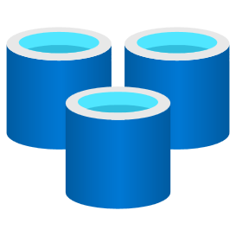
Azure Redis Cache
March 14, 2023

Slide 2
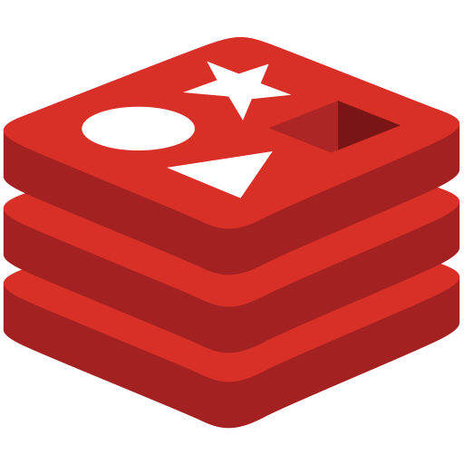
What is Redis?
Open-source
In-memory
Key-value
NoSQL datastore
>SET key “Hello World!”
>GET key
“Hello World!”
Notes:
This may not sound too, thrilling, so why does this matter? [Slide]

Slide 3
What’s Special About Azure Cache for Redis?
Fast
Loved
Fully Managed
Data is stored in-memory, not on disk
Updates, patching, and scaling handled for customers
Higher reliability with automated failover and geo distribution
Built-in Security and interoperability with Azure services
< 1ms latency
2M+ requests/second
100k+ simultaneous clients
The most loved database in Stack Overflow’s Developer Survey for five years in a row
Notes:
Redis is the fastest database on Azure. Which is why it’s typically used as a cache
Developers love open source redis, which is what Azure Cache for Redis is built on.
WE take that open source version and make it a PaaS service.

Slide 4















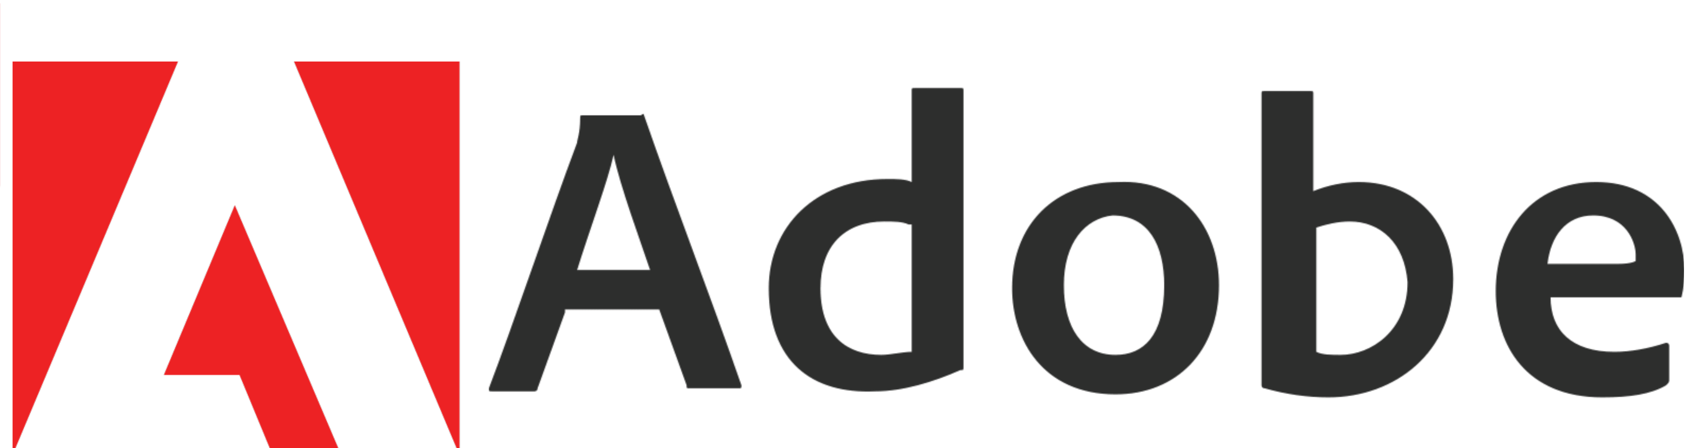
Widely Used by Innovative Enterprise Customers

Slide 5
Your App. Faster.
High-level use cases for Azure Cache for Redis
Cache/app accelerator
Data store
Messaging/streams
Migration
Examples
Reduce database access costs
API response caching
ML feature store
Accelerate stream processing
Share state across cloud
Optimize memory for k8s pods
User session data store
Accelerate datastore access
Microservices state store
Message broker
Dev/test alternative for CosmosDB
Share state in hybrid environment

Slide 6
Distributed cache
USE CASE 1
Distributed caches improve app response times and reduce costs by copying frequently accessed data to a cache with lower latency and higher throughput than the primary datastore
Key Capabilities
Speeds up applications through millisecond or faster response times
Reduces load on database and compute resources
Optimize memory requirements for Kubernetes pods
Share state across microservices

Slide 7






Azure Cache for Redis to accelerate database
USE CASE 1
Use case examples
Handling spikes in traffic during major events
Serving commonly accessed data to users, like inventory or pricing data
Reducing compute load on a database
Placing content geographically closer to a consumer
Example architecture
Azure SQL Database
Browser
Azure Web Apps
Azure Cosmos DB
Azure Cache for Redis
Azure Database for MySQL
Mobile device
Azure API App Instance
Azure Database for PostgreSQL
Azure Storage
Azure Cache for Redis improves Chipotle website performance with reliable in-memory caching
Notes:
https://customers.microsoft.com/en-us/story/787157-chipotle-retailers-azure

Slide 8
Data store
USE CASE 2
A session-oriented application needs to temporarily store and access session data when the user logs in and remains active
Key Capabilities
Smoothly handle hundreds of thousands of simultaneous users
Built-in data replication options for maximum reliability
Typically more cost effective and scalable than database or storage options

Slide 9

Azure Cache for Redis is an efficient session store solution
USE CASE 2
Use case examples
eCommerce shopping carts
Storing user cookies
User login and session state
Customized pricing quotes
IoT telemetry
Example architecture
Browser
Azure API App Instance
Browser
Azure API App Instance
Azure Cache for Redis
Browser
Azure API App Instance
GEICO uses Azure Cache for Redis to store insurance quotes for customers shopping online
Notes:
https://customers.microsoft.com/en-us/story/geico

Slide 10
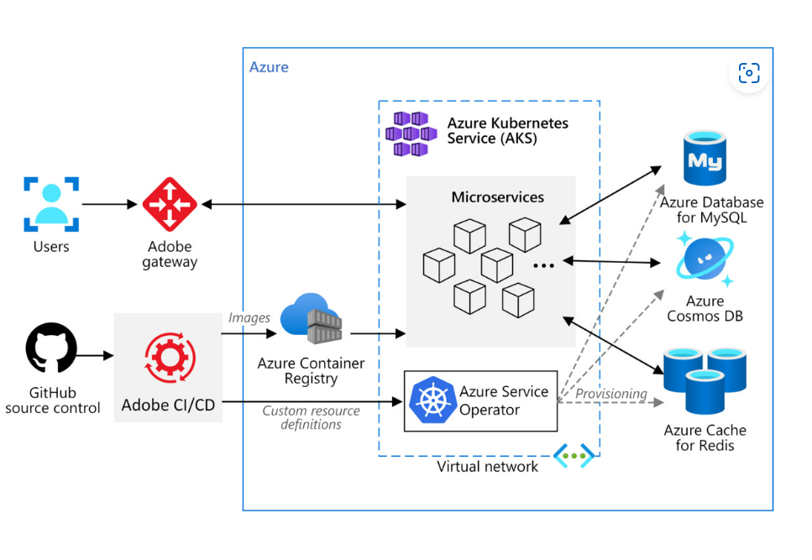

Azure Cache for Redis as state information store
USE CASE 2
Example architecture
Use case examples
Optimize memory requirements for AKS pods
Store ephemeral state information
Cache responses to expensive API calls
Azure Cache for Redis facilitates inter-service communication and maintains state information
Notes:
Microsoft Customer Story-Adobe gets control plus flexibility in its development platform from the Azure Service Operator project

Slide 11
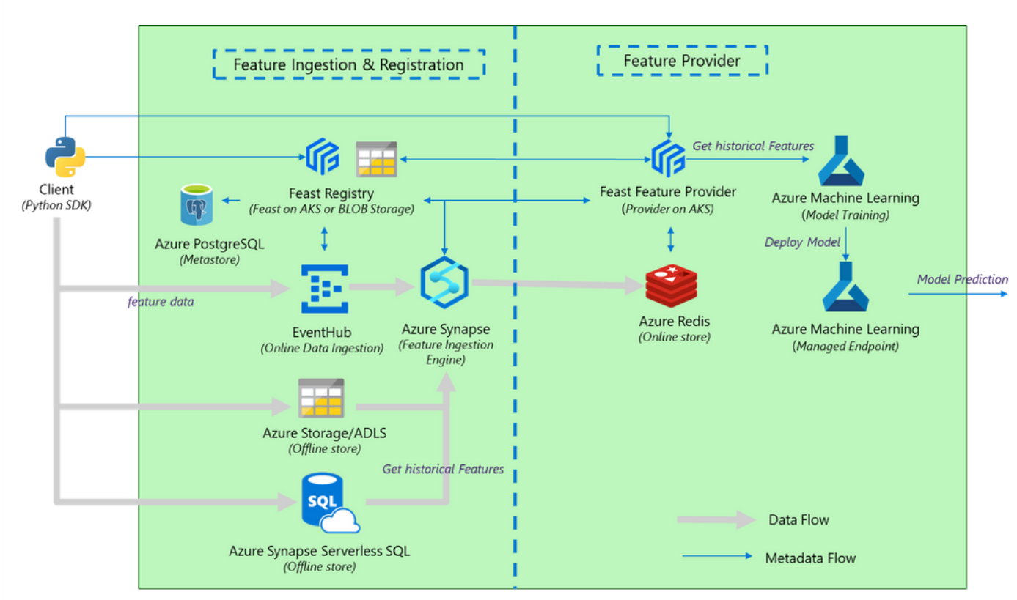
Azure Cache for Redis as AI/ML feature store
USE CASE 2
Example architecture
Use case examples
Online data store
Quick look up to accelerate real-time analysis
Super low latency coupled with extremely high throughput
Notes:
Bringing Feature Store to Azure - from Microsoft Azure, Redis, and Feast Community

Slide 12
Message broker
USE CASE 3
Apps built on microservices often need a way for those services to asynchronously communicate. A cache can implement a publish/subscribe or queue architecture to enable fast and reliable communication between these microservices.
Key Capabilities
Built-in pub/sub and messaging functionality
Support for industry-standard TLS encryption for data in transit
Network isolation for secure communication between services

Slide 13

Publish, subscribe, and query with Azure Cache for Redis
USE CASE 3
Use case examples
Publishing news, financial data, or application updates to users
Handling chat messages
Communication between microservices
Example architecture
Group Chats
Azure Web Apps
Browser
Stock Quotes
Azure Cache for Redis
Azure API App Instance
Windows App
Notification Messages
Azure API App Instance
Mobile device
Azure Cache for Redis helps Qatar’s leading food delivery app streamline orders with microservices
Notes:
Microsoft Customer Story-Snoonu aims to become Qatar’s first unicorn. Microsoft Azure has been supporting them to achieve that goal
Another great example: Microsoft teams!

Slide 14


Accelerate data stream processing
USE CASE 3
Stream processing speed and reliability is vital, especially for real-time decision-making scenarios like fraud detection, stock markets, IoT telemetry. A cache can accelerate data processing by providing highly scalable and performant lookups and data store.
Key Capabilities
Great ephemeral data store with minimal overhead and cost
Support for sub-millisecond latencies with extremely high throughput
Built-in datatype - Redis streams

Slide 15
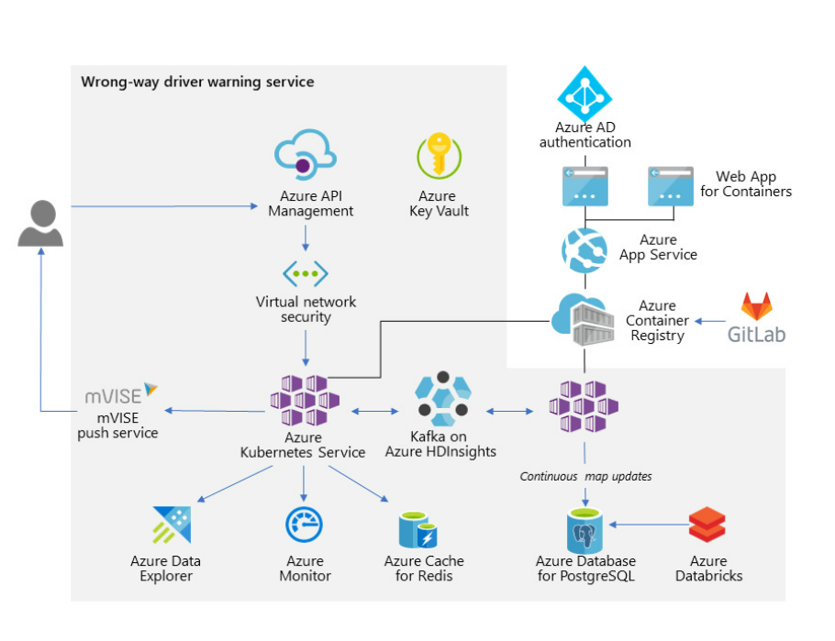

Process your data stream faster with Azure Cache for Redis
USE CASE 3
Example architecture
Use case examples
Ephemeral data store
Quick look up to help map IoT device to customer profile
Reduce database lookups
Azure Cache for Redis accelerates processing streams from IoT device telemetry
Notes:
Microsoft Customer Story-Bosch increases vehicle safety using map-matching algorithms and Azure Kubernetes Service

Slide 16
Cloud migration
USE CASE 4
As systems modernize from on-premises to IaaS and PaaS offerings, caching becomes more valuable as a fully managed service
Key Capabilities
Import and export RDB files to smoothly migrate data from on-prem Redis to Azure Cache for Redis
Compatible with open-source Redis for simple migration
Fully managed service that handles patching, updates, provisioning, scaling, and setup for you

Slide 17
Take advantage of compatibility with open-source Redis to migrate data
USE CASE 3
Use case examples
Migrating application from on-premises to the cloud
Modernizing IaaS application through new PaaS services
Example architecture
On-Prem Redis Cache
Export cache into RDB File
Create Azure Cache for Redis Instance
Import RDB file into Azure Cache for Redis
Configure application to point at new cache instance
The Nobel Prize website migrated setup to Azure, including Azure Cache for Redis, to effectively scale website performance when prizes are announced
Notes:
https://customers.microsoft.com/en-us/story/nobel-media-media-telecommunications-linux-on-ase

Slide 18

Azure Cache for Redis Offerings
 | Basic | Standard | Premium | Enterprise | Enterprise Flash
Replication | No replication | Built-in replication | Built-in replication | Built-in replication | Built-in replication
Memory Size | 250 MB – 53 GB | 250 MB – 53 GB | 6 GB – 1.2 TB | 12 GB – 1 TB | 384 GB – 13 TB
Availability | N/A | 99.9% | 99.9% | Up to 99.999% | Up to 99.999%
Scaling | Vertical | Vertical | Horizontal & vertical | Coming soon | Coming soon
Network Performance | Low to high | Low to high | Moderate to highest | Moderate to highest | Moderate to highest
Data Persistence |  |  |  | (preview) | (preview)
Redis Cluster
Network Isolation | Private Link | Private Link | Private Link (and VNET) | Private Link | Private Link
Geo-Replication |  |  | Passive | Active | Active
Zone Redundancy
Redis Modules
Redis on Flash
*
https://azure.microsoft.com/ja-jp/pricing/details/cache/
*Only RediSearch & RedisJSON

Slide 19
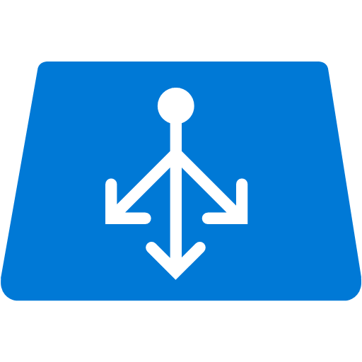


Inside | Basic
Single node running OSS Redis (on Windows)
Non-TLS 6379 is disabled by default
Data is not replicated
Data loss will happen during patching or scaling
No explicit SLA guarantee. Good for dev-test
Load Balancer
Non-TLS 6379
TLS 6380
Azure Cache Agent
OSS Redis (Windows)
VM

Slide 20
Inside | Standard/Premium
Consists of two nodes: primary and a replica
Load balancer distributes connections to both primary and replica, but replica then forwards to primary, so eventually only primary serves request from client
Primary copies data asynchronously to replica
When primary is not available (crash or update), replica will become primary automatically
99.9% availability is guaranteed via such a mechanism
Load Balancer
Non-TLS 6379
TLS 6380
Non-TLS 6379
TLS 6380
Primary
Replica
Azure Cache Agent
Azure Cache Agent
Aysnc Replication
OSS Redis (Windows)
Forward
OSS Redis (Windows)
VM Set

Slide 21

Inside | Replication & failover
Sync data from primary to replica
Replica then becomes primary
Primary becomes unavailable
Existing connections are dropped; client will receive failures and needs to reconnect with new primary
Eventually new replica will get up and sync data from new primary
New replica gets ready to pair with new primary
Client
Load Balancer
Non-TLS 6379
TLS 6380
Non-TLS 6379
TLS 6380
Replica
Replica
Azure Cache Agent
Primary
Primary
Azure Cache Agent
Aysnc Replication
OSS Redis (Windows)
Forward
OSS Redis (Windows)
VM Set

Slide 22
Inside | OSS Clustering
Consists of multiple shards. Each shard is a primary/replica pair. Each node handles a subset of the 16384 hash slots. All nodes will sync with each other via cluster bus internally. Replica will forward connections to primary.
After the first connection is established, client will download the list of nodes. Later all connections are made to nodes directly, bypassing load balancer
Client calculates the hash slot from key [HASH_SLOT = CRC16(key) mod 16384]. If it sends the key to wrong shard, that shard will reply with a MOVED response, indicating which node it should send to
Client
Load Balancer
Sends requests to any arbitrary node, no special setting for Redis
Non-TLS 6379
TLS 6380
Non-TLS 6379
TLS 6380
Non-TLS 6379
TLS 6380
Non-TLS 6379
TLS 6380
Azure Cache Agent
Replica
Azure Cache Agent
Primary
Azure Cache Agent
Primary
Replica
Azure Cache Agent
Aysnc Replication
Aysnc Replication
OSS Redis (Windows)
Forward
OSS Redis (Windows)
OSS Redis (Windows)
OSS Redis (Windows)
Forward
Shard A for hash slots from 0 to 8191
Shard B for hash slots from 8192 to 16383
Cluster bus

Slide 23
Scaling
Vertical scaling – switching cache size and/or tier
Scales up to any tier or size
Scales down within the same tier
Live-migrates data transparently to applications
Horizontal scaling – turning on OSS clustering in Premium tier
Automatically splits your dataset among multiple nodes
Continues operations when a subset of the nodes are experiencing failures or unable to communicate with the rest of the cluster
Scales throughput linearly as you increase the number of shards
Scales memory size linearly as you increase the number of shards
Live-migrates data transparently to applications
Scale cluster in or out

Slide 24
High availability and disaster recovery
Standard replication
Zone redundancy
Allows additional replicas
Provides automatic failover
Persistence (AOF/RDB)
Append-Only File – stores every write
Redis Database – point in time snapshots
Import/Export
Geo-replication
Link caches in two regions, data from primary replicated to secondary

Slide 25
Inside | Zone Redundancy
Depending on availability zone and replica count configuration, primary and replica nodes are provisioned in different availability zones
If Availability Zone 1 goes down, the replica in Availability Zone 2 will automatically failover to become the primary node for the cache.
Client
Load Balancer
Sends requests to any arbitrary node, no special setting for Redis
Non-TLS 6379
TLS 6380
Non-TLS 6379
TLS 6380
Non-TLS 6379
TLS 6380
Replica#1
Primary
Replica#2
Azure Cache Agent
Azure Cache Agent
Azure Cache Agent
Aysnc Replication
Aysnc Replication
OSS Redis (Windows)
Forward
OSS Redis (Windows)
OSS Redis (Windows)
Forward
Availability Zone 1
Availability Zone 2

Slide 26
Inside | Geo-replication
Geo-Primary cache in region A is available for read/write, Geo-Secondary cache in region B is read-only cache
Async data replication in place between Geo-Primary and Geo-Secondary caches.
If region A goes down, customers need to unlink caches and then divert their applications to read/write from Geo-Secondary cache instead
Client
Geo-Primary in Region A
Geo-Secondary in Region B
Non-TLS 6379
TLS 6380
Non-TLS 6379
TLS 6380
Non-TLS 6379
TLS 6380
Non-TLS 6379
TLS 6380
Primary
Replica
Replica
Replica
Azure Cache Agent
Azure Cache Agent
Azure Cache Agent
Azure Cache Agent
Aysnc Replication
Aysnc Replication
Aysnc Replication
OSS Redis (Windows)
Forward
OSS Redis (Windows)
OSS Redis (Windows)
OSS Redis (Windows)
Forward

Slide 27
Inside | Geo-failover
Traffic manager backed write endpoint which always points to Geo-Primary
If region A goes down, customer initiates geo-failover which causes Geo-Secondary to being Geo-Primary and vice versa
Write Endpoint updated automatically to point to new Geo-Primary
Client
Write Endpoint DNS records
Geo-Primary in Region A
Geo-Secondary in Region B
Non-TLS 6379
TLS 6380
Non-TLS 6379
TLS 6380
Non-TLS 6379
TLS 6380
Non-TLS 6379
TLS 6380
Primary
Replica
Replica
Replica
Azure Cache Agent
Azure Cache Agent
Azure Cache Agent
Azure Cache Agent
Aysnc Replication
Aysnc Replication
OSS Redis (Windows)
Forward
OSS Redis (Windows)
OSS Redis (Windows)
OSS Redis (Windows)
Forward

Slide 28
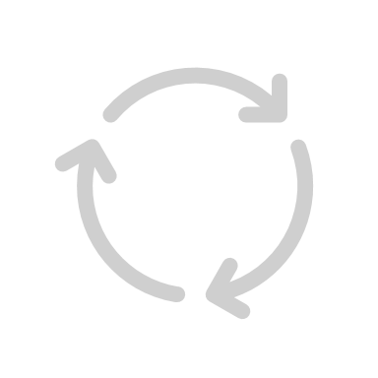

Inside | Persistence
Load Balancer
Perform point-in-time snapshots of the Redis cache in a binary format, written to customer’s Azure storage account
Two types
RDB Snapshot
AOF (Append Only File) – near continuous write
If a catastrophic event occurs that disables both nodes, the cache is reconstructed using the most recent data from storage
Persisted data cannot be used to reconstruct a different cache
Use Import/Export to move data across caches
Non-TLS 6379
TLS 6380
Non-TLS 6379
TLS 6380
Primary
Replica
Azure Cache Agent
Primary
Replica
Azure Cache Agent
Aysnc Replication
OSS Redis (Windows)
Forward
OSS Redis (Windows)
Frequency options
15 minutes
30 minutes
60 minutes
6 hours
12 hours
24 hours
Persist frequently
Take snapshot
RDB
Azure Storage

Slide 29
Azure Cache for Redis Offerings
 | Basic | Standard | Premium | Enterprise | Enterprise Flash
Replication | No replication | Built-in replication | Built-in replication | Built-in replication | Built-in replication
Memory Size | 250 MB – 53 GB | 250 MB – 53 GB | 6 GB – 1.2 TB | 12 GB – 1 TB | 384 GB – 13 TB
Availability | N/A | 99.9% | 99.9% | Up to 99.999% | Up to 99.999%
Scaling | Vertical | Vertical | Horizontal & vertical | Coming soon | Coming soon
Network Performance | Low to high | Low to high | Moderate to highest | Moderate to highest | Moderate to highest
Data Persistence |  |  |  | (preview) | (preview)
Redis Cluster
Network Isolation | Private Link | Private Link | Private Link (and VNET) | Private Link | Private Link
Geo-Replication |  |  | Passive | Active | Active
Zone Redundancy
Redis Modules
Redis on Flash
*
*Only RediSearch & RedisJSON

Slide 30

Resiliency
Perfect for Cloud Native Development
3,415 ms
Performance
95% Latency
Up to 11X better latency performance
271 ms
Baseline app performance
App performance with
Azure Cache for Redis¹
Up to 99.999%
Availability
Industry-leading availability
Active geo-replication for global distribution with local latency
¹Performance claims based on data from a study commissioned by Microsoft and conducted by GigaOm in October 2020. The study compared the performance of a test application using an Azure database with and without implementing Azure Cache for Redis as a caching solution. Azure SQL Database and Azure Database for PostgreSQL were used as the database element in the study. A 2 vCore Gen 5 General Purpose instance of Azure SQL Database and a 2 vCore General Purpose instance of Azure Database for PostgreSQL were used with a 6 GB P1 Premium instance of Azure for Redis. These results were compared with 8, 16, 24, and 32 vCore Gen 5 General Purpose instances of Azure SQL DB and 8, 16, 24, and 32 vCore General Purpose instances of Azure Database for PostgreSQL without Azure Cache for Redis. The benchmark data is taken from the GigaOm Web Application Database Load Test which simulates a common web application and backend database barraged by increasing HTTP requests. Actual results may vary based on configuration and region.
Notes:
The Azure Cache for Redis Enterprise offering provides what you need to be cloud native:
Performance: cloud-native is all about speed and responsiveness. That’s something that Redis has always been good at. We hired an independent 3rd party vendor to benchmark application performance on Azure with and without Azure cache for Redis. The results were remarkable—with Azure Cache for Redis, the application saw 8X higher throughput and 11X better latency performance.
Availability: Especially in mission-critical industries like healthcare, finance, and retail, high availability is table stakes in adopting Redis in the cloud. With Enterprise, we can provide up to 99.999% uptime, opening new industries to Redis.
Resiliency: One of the best reasons to develop on the cloud is the global network of infrastructure you can tap into. With active geo-replication, you can take advantage of the huge number of Azure datacenters across the world to distribute your data globally--making your application more resilient and more scalable.
We’re really excited about the possibilities of using active geo-replication on Azure infrastructure, so I’m going to turn it over to Kyle for a quick demo of what it looks like in Azure. Kyle?

Slide 31
Redis Enterprise Architecture

Slide 32


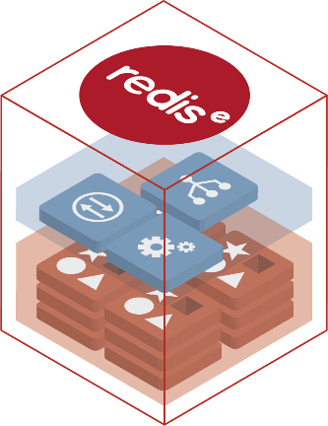
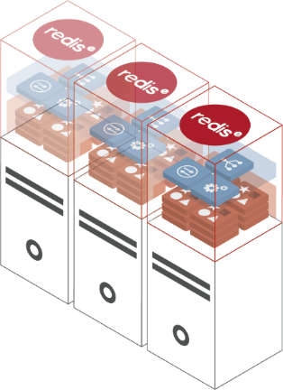
Redis Enterprise Terminology
Redis Instance – single-threaded Redis OSS database
Commonly referred to as a shard with either a role as a master or slave
Redis Enterprise Database – logical entity that manages your entire dataset across multiple Redis Instances
not to be confused with the OSS database inside every Redis instance
multi-tenant, maximizing infrastructure utilization (reduces overall TCO)
Redis Enterprise Nodes – physical servers, virtual machines, containers, and/or cloud instances
on which the Redis Enterprise installation package is installed and configured
each node is a container capable of running multiple Redis Instances (i.e., shards)
Redis Enterprise Cluster – set of Redis Enterprise nodes pooling resources
allows you to create any number of Redis Enterprise nodes to scale up/out
Notes:
Some terminology for Redis Enterprise may be helpful:
- A Redis instance is a single instance, or shard, of a single-threaded Redis OSS database - these are the types of instances that developers spin up every day in docker containers and on their laptops
- A Redis Enterprise database is the logical representation of all of the data spread across multiple instances of Redis
- Redis Enterprise Nodes are the physical servers, VMs or containers on which the Redis Enterprise stack exists and which may contain multiple Redis instances
- And finally a Redis Enterprise Cluster is the set of all of the nodes which are configured to pool their resources in the database- in this respect you could think of a K8s analogy where multiple nodes are managed by a control plane. In this case there is a management tier of software ensuring that all of the nodes and instances are up and running and handling instances of failure throughout the cluster of nodes and instances.

Slide 33

Redis Enterprise Node
Cluster Management
Govern Cluster, Orchestrate Failure Detection, Failover, Stats Collection & more
Secure UI & REST API
Allow programmable and visual administration over HTTPS
Redis Instances
Based on Open Source Redis
Proxy
Scale Connections
Improve Application Performance
Notes:
Let’s get more granular and look at a Redis Enterprise node and show the major architectural differences between these nodes and single Redis instances.
- First, each Redis Enterprise node contains a set of cluster management software which helps to govern cluster behavior, orchestrate failure detection and failover as well as emit telemetry data and general cluster health.
- Second, each Redis Enterprise node hosts a secure UI and REST API which allow programmatic and visual administration of the cluster.
- Third, and something which should be of great interest, is the proxy, which exists to optimize connections and commands while scaling requests to the cluster out to our single-threaded instances in a multi-threaded fashion. This optimization is part of what allows Redis Enterprise to have very high throughput and mitigate issues such as network saturation and system back pressure which can become an issue with OSS Redis at scale.
- Finally, each Redis Enterprise node can contain 0 to many individual Redis instances which are controlled and maintained by the previously mentioned components. Note that in a Redis Enterprise Cluster, each data node has at least one secondary, or replica, node to which it can immediately failover in the event of node/vm failure. When orchestrated by the cluster manager, this happens automatically and the proxy reconfigures the local network requests to ensure extremely small application effects.

Slide 34
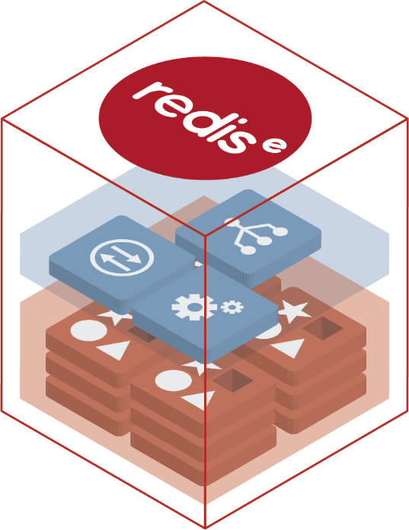
Shared-Nothing Symmetric Architecture
a
Node Watchdog
Cluster Watchdog
Cluster
Management
Path
Redis Shards
Proxies
Database discovery
Data Path
Node 1
Node 2
Node N (odd number)
Notes:
All of these components come together in Redis Enterprise in a "shared nothing" architecture in which each node contains a full set of the management and governance software to maintain cluster health. Also, remember that in all Redis clusters, there exists replicas for the data nodes as well as a "quorum only" node which contains all of the software of a Redis Enterprise node but does not host data, as it exists to break election contention when leader nodes failover to replica nodes to ensure seamless HA within the cluster.

Slide 35
Active Geo-Replication

Slide 36

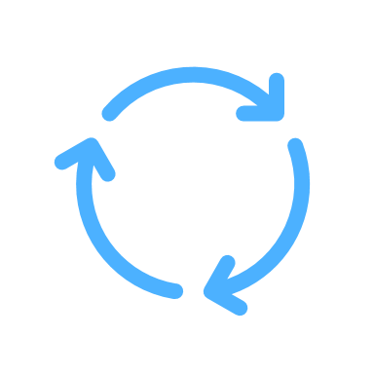



Active Geo-Replication
Overview
Geo-replication links together two Premium Azure Cache for Redis instances and creates a data replication relationship. Some of primary benefits on enabling this feature includes:
Read & Write Simultaneously
Simultaneous read & write operations on multiple globally distributed instances
Scalability
Scale worldwide with the same local latency
Data Consistency & Resilience
Greater resiliency and data consistency across the globe

Slide 37

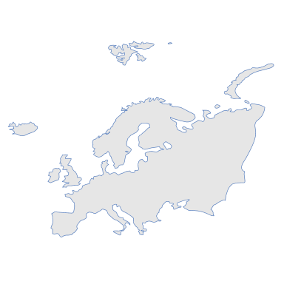


Active Geo-Replication Use Cases
Roaming user sessions
Handle region failures
Geo-distributed applications
₽
₹
¥
$
Notes:
Here are some examples of how this can be used:
Migrating User Sessions:
Redis is frequently used to store user session data. (e.g. A coffee company storing a user’s favorite mobile app order)
But what happens if the user travels away from the data center holding their data? (e.g. they take a flight from London to Paris) They get increased latency and lower performance.
With active geo-replication, however, their session data can be distributed worldwide and they can simply connect to the instance closest to them.
Handle Node Failures:
Likewise, if a single node fails for any reason, active geo-replication means that they can simply switch to the next closest node, and their data is the same.
Geo-Distributed Applications:
Many applications today must operate globally. (Examples: a banking app available worldwide, a mobile game with a global leaderboard)
Active Geo-Replication allows for cached data to be shared wherever a user goes
(Examples: You stay logged into your banking app in different regions, mobile games can update the global leaderboard with local latency)

Slide 38


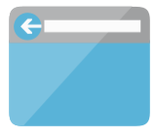



Architecture—Shopping Cart
3
1
Browser/Mobile App
Azure App Service
2
Azure Cache for Redis
(globally replicated)
1
2
3
Azure App Service
Azure Cache for Redis is used to store user session data like login tokens and shopping cart information
Using active geo-replication, a customer’s data can be automatically duplicated to other regions in a multi-master configuration, allowing for users to seamlessly move between regions

Slide 39
Industry-Leading Availability SLAs
99.9%
99.99%
99.999%
Default
Multi-AZ
Active Geo-Replication
Built-in replication with automatically failover to replica node
Placing replicas in different availability zones
Adding multi-primary writes across regions
Notes:
Because of Active Geo-Replication and Zone Redundancy capability, Azure Cache for Redis now has high availability options—up to five nines!

